Slide 1


Alpha Phi Omega
Chi Chapter at UCLA
Alpha Kappa / David A. Emery Term, Meeting 1
October 9, 2013
www.apo-x.org

Slide 2
Agenda
1. Officer Updates and Announcements
2. Chapter Business
3. Last Announcements

Slide 3
President
Holly Fuong
president@apo-x.org
Executive Committee
excomm@apo-x.org

Slide 4
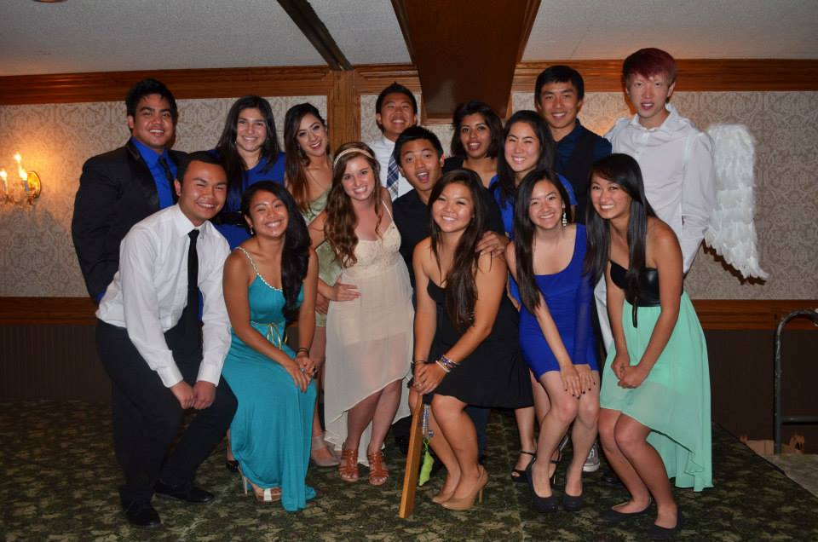
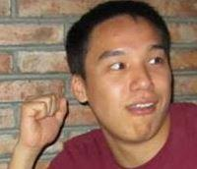
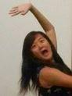
Alpha Kappa Excomm!

Slide 5
Alpha Kappa Excomm is here,
time for L-F-S
I'm Holly Fuong your new leader,
time, for a big success

Slide 6
Admin's here to say,
website is on it's way
don’t worry we will fix it

Slide 7
Membership says hi
we will always try
to entertain you

Slide 8
We're gonna come and take it all
Excomm is here to make it all
LFS we're gonna show you all
there is nothing we can't do,
all we need is you
yeah you
all we need is you

Slide 9
Nothing to fear,
fellowship's here
Finance always has your back

Slide 10
SAA here,
the rules are clear
Pledge Parents will teach you what to do

Slide 11
Selener is on her way
with pictures of everyday
so you will never forget

Slide 12
Service will lead the way,
With cute dogs everyday
I’ll get IC’s to come too

Slide 13
We're gonna come and take it all
Excomm is here to make it all
LFS we're gonna show you all
there is nothing we can't do,
all we need is you
yeah you
all we need is you

Slide 14
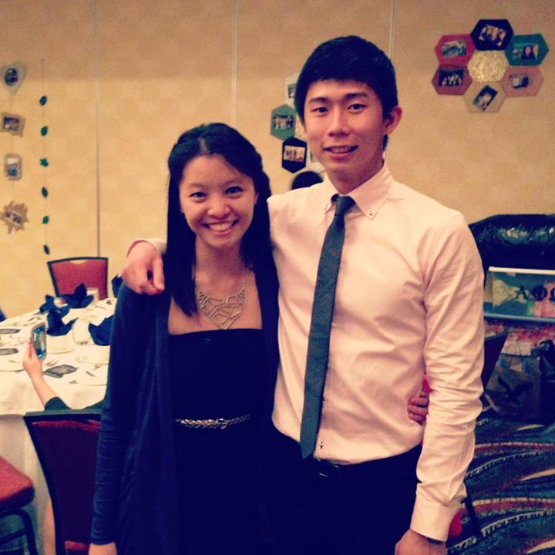
Philanthropy Chairs

Slide 15
Administrative VPs
Jacqueline Pan & Melanie Teepronpirut
admin@apo-x.org

Slide 16
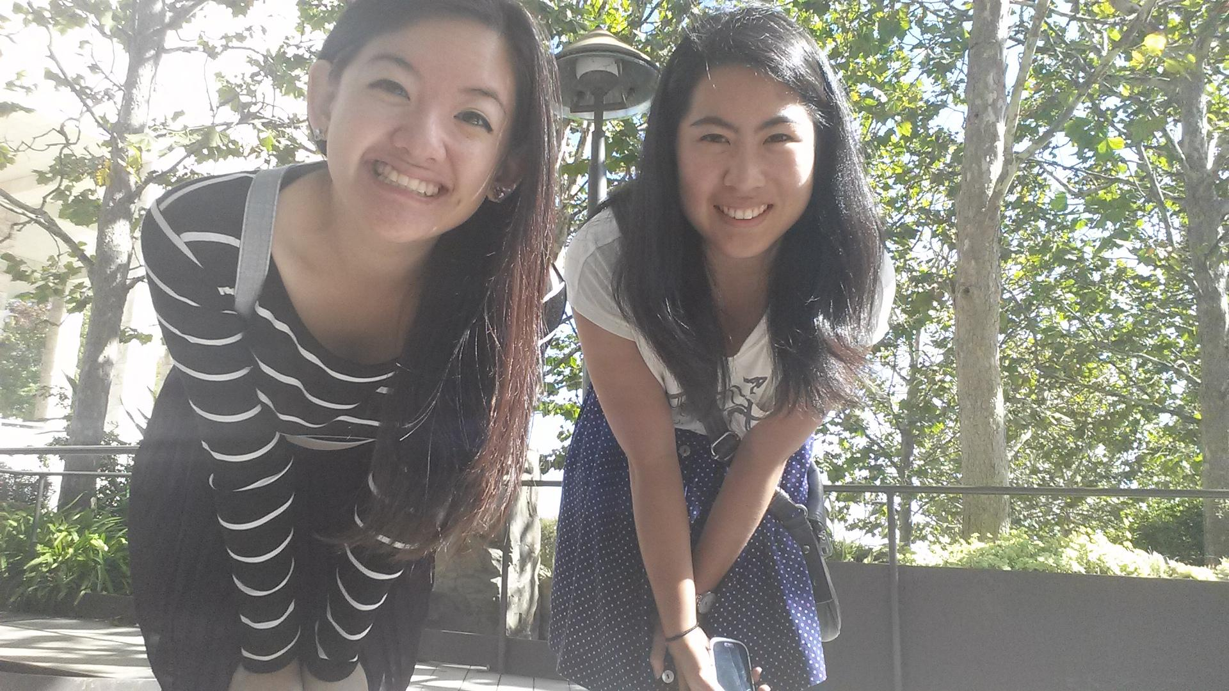
Your Fabulous Admin VPs!

Slide 17



What do we do?
Answer all your questions about the website and how to use it
Keep you guys updated with Chi chapter happenings
Maintain alumni relations

Slide 18
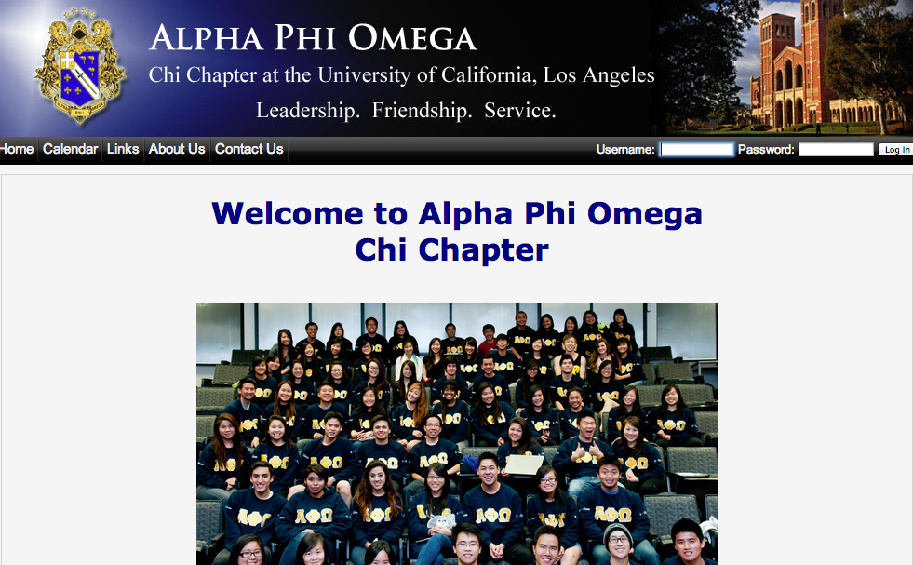
Website - APO-X.ORG
Log in: your email
Password: you will make your own

Slide 19
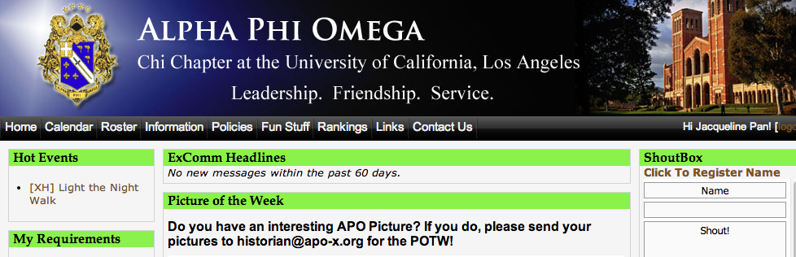
How to sign up for events
Click on CALENDAR

Slide 20
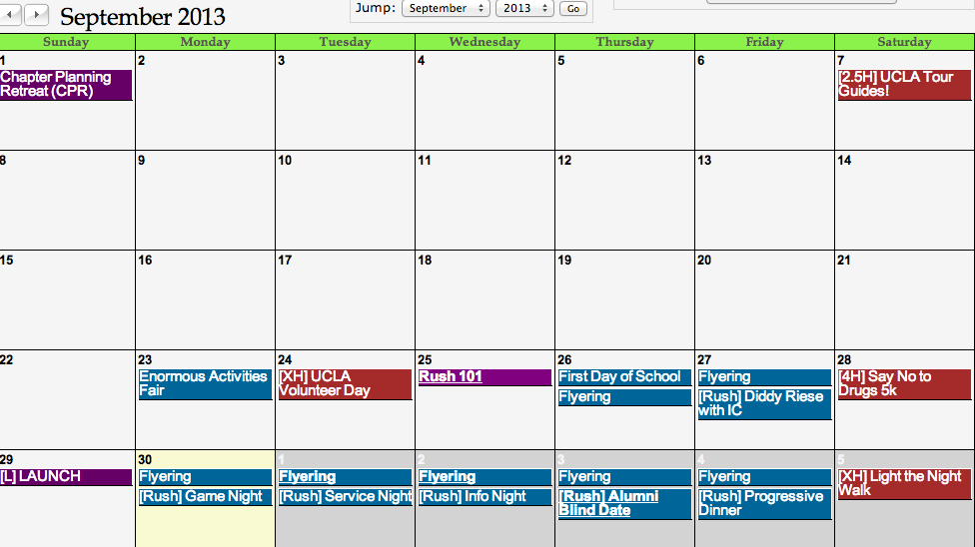
Click on desired event

Slide 21
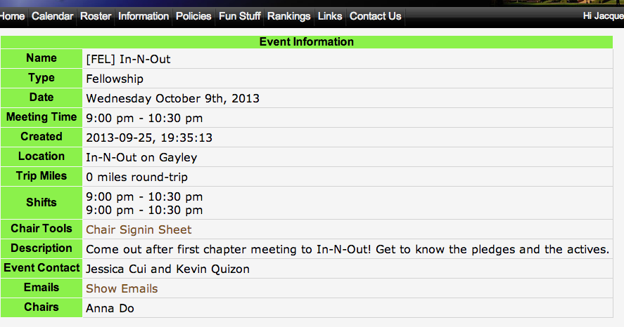
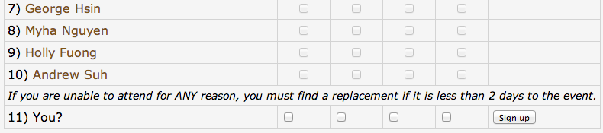

Slide 22
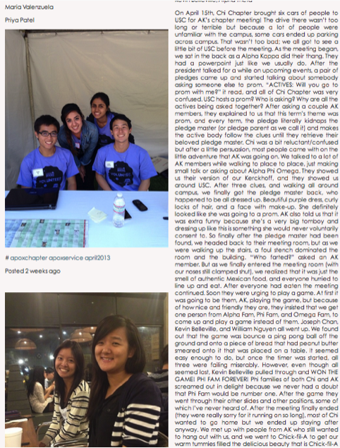
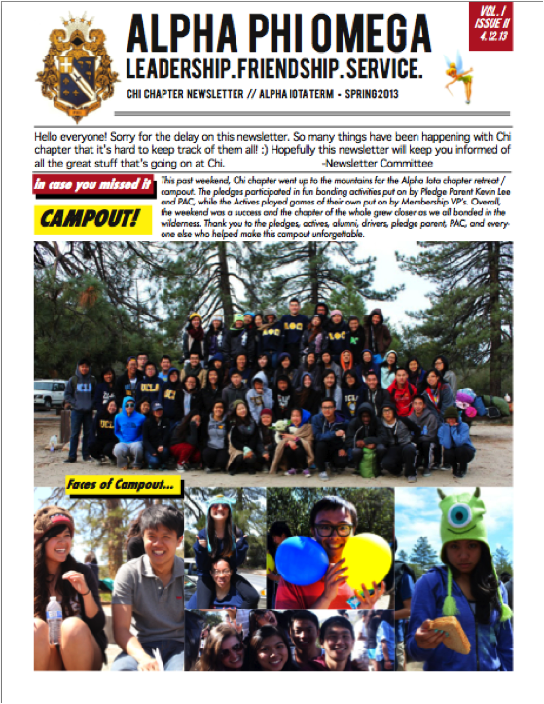
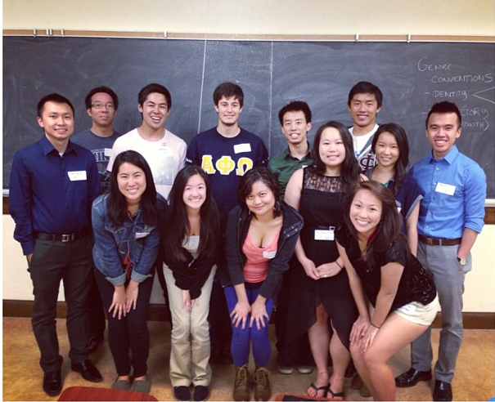
Join Our Committees! (:
Newsletter (2)
Help create pretty bi-weekly newsletters
Tumblr (1)
Update the Chi tumblr page
www.apochichapter.tumblr.com
Alumni (3)
Help plan alumni networking night & organize mini alumni gatherings

Slide 23
Membership VPs
Vivian Kwan & Sean Tran
membership@apo-x.org

Slide 24
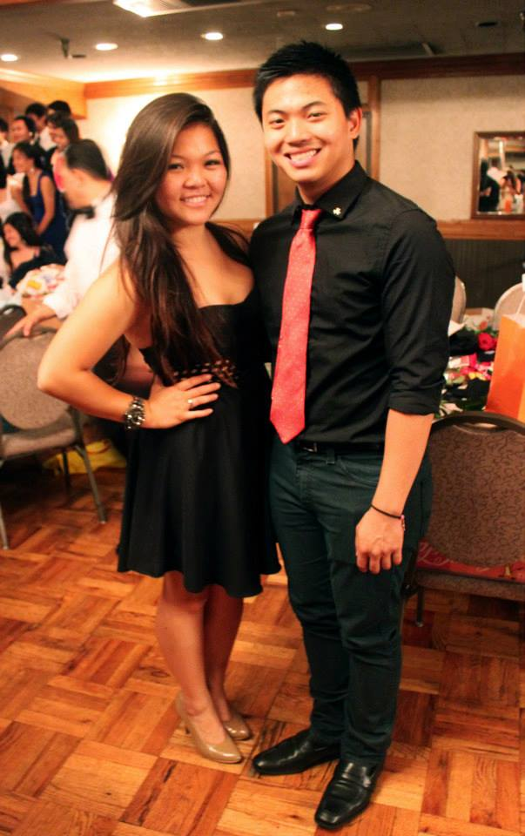
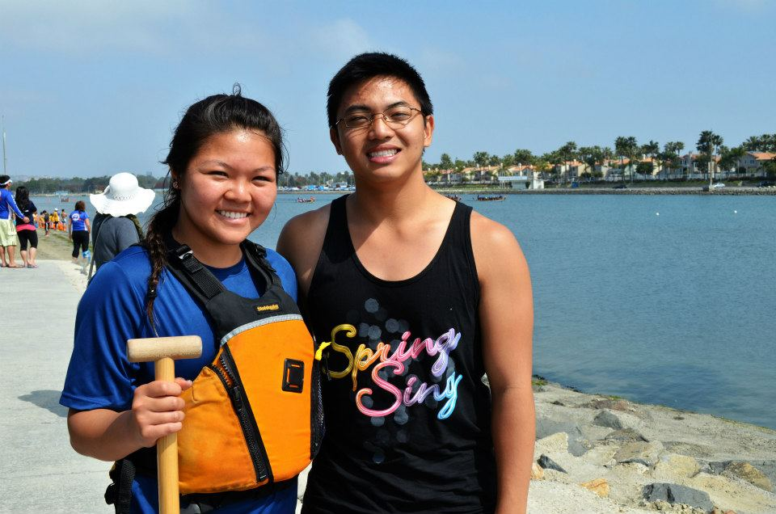
Who are we? What do we do?

Slide 25

NOTHING BRINGS US CLOSER TOGETHER

Slide 26


Alpha Kappa Fam Heads
Will be introduced next meeting. Get excited.

Slide 27
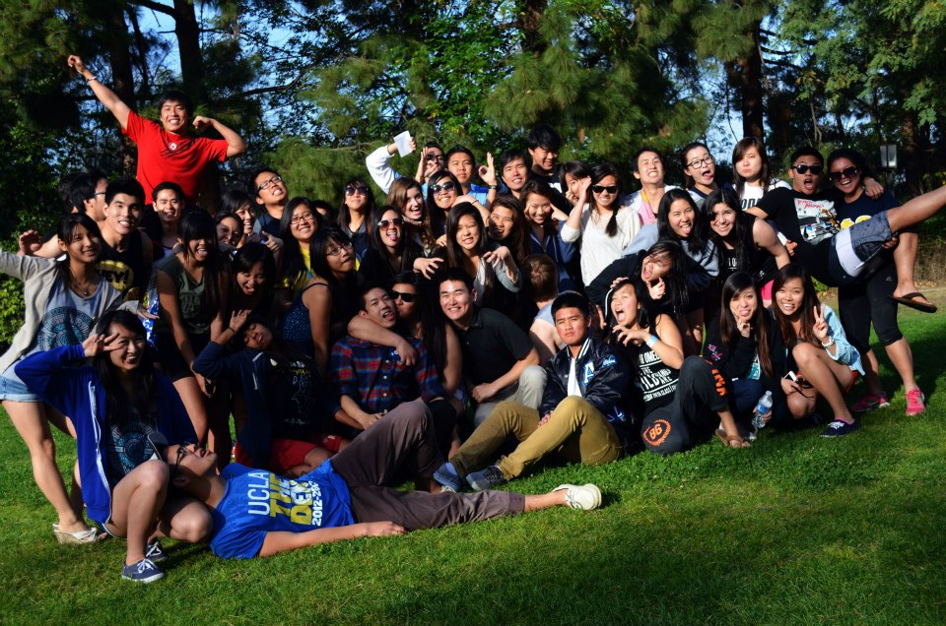
Active Bonding Day

Slide 28
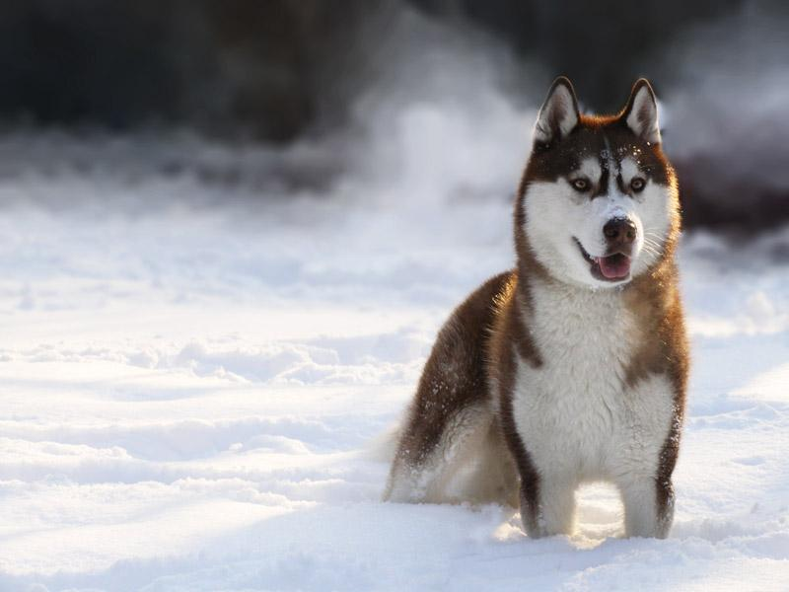
Chapter Snow Day/Retreat
Mt High 1.4 hours
Big Bear 2.6 hours
Before or after Christmas break?
Weekend affair
30-50 $

Slide 29

Business
Contracts
Rush Make ups
Committees

Slide 30

Actives!
THE PLEDGES ARE HERE. be nice.

Slide 31
First CM Game of the year

Slide 32
Service VPs
Kevin Qiu & Gabrielle Taylor
service@apo-x.org

Slide 33
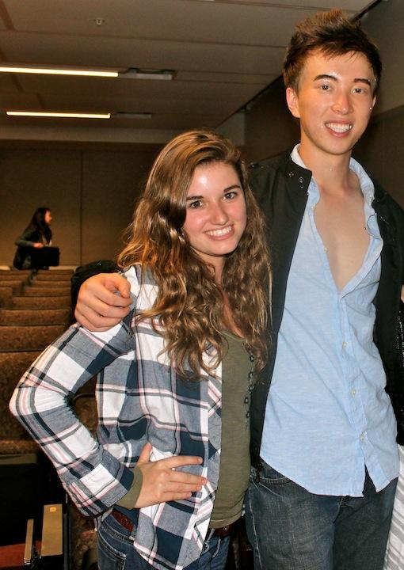
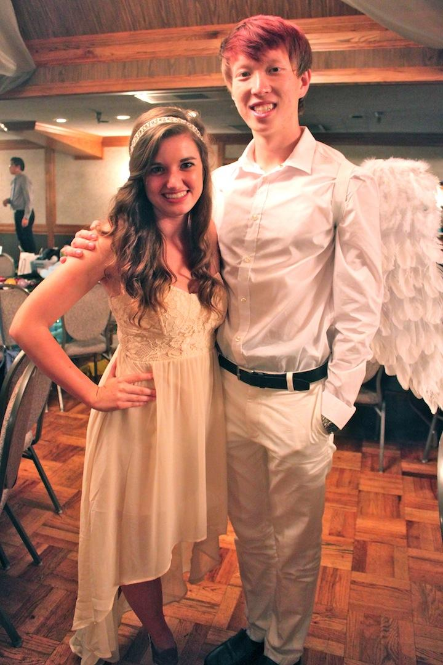
Service VPs (:

Slide 34
AK Service Policies
No more than 8 hours can be received for any single service event
A blood donation can be turned in for 3 service hours
Individual service hours will not be accepted

Slide 35
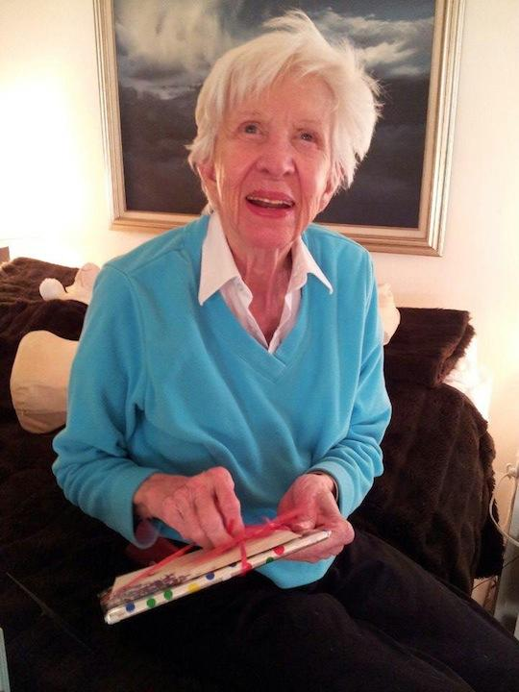
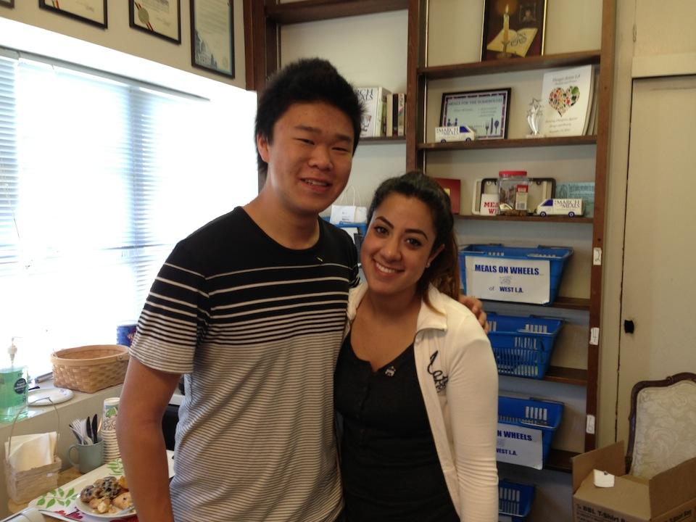
AK Service Policies
Meals on Wheels & Monday Night Mission can always be requested to be put up on a specific date AS LONG AS you tell service vps at least to 3 days before.

Slide 36
Upcoming Service
10/12: Reading to Kids
Inspiration for College
10/14: Monday Night Mission
10/15 (& every Tuesday): Wheelchair basketball
10/19: Green Festival LA
10/20: Green Festival LA
KEEN LA
Trick-or-Treat Bag Making

Slide 37
Pledge Parents
Hamilton Luu & David Yuan
pledgeparents@apo-x.org

Slide 38
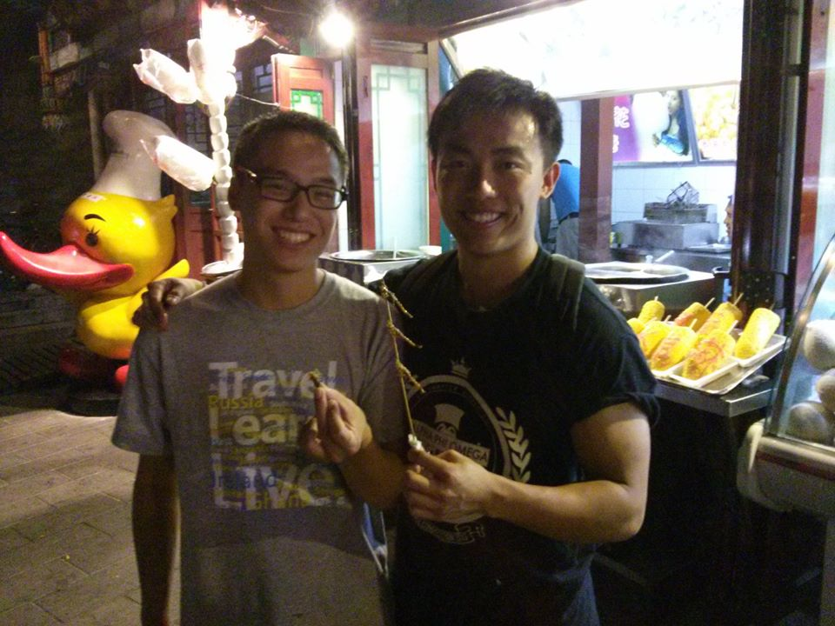
Pledge Parents

Slide 39
Reminders to Actives
We need all of your support!!!!
No one will know if you don’t speak up
Talk to us if you have any concerns

Slide 40
Updates
Class roster, cardinal principles, and fraternity motto
10 pledges, 1 active, 1 PAC/Pledge Parent
Pledge Bonding Day

Slide 41
Finance VPs
Alejandra Chavez & Raymond Mai
finance@apo-x.org

Slide 42
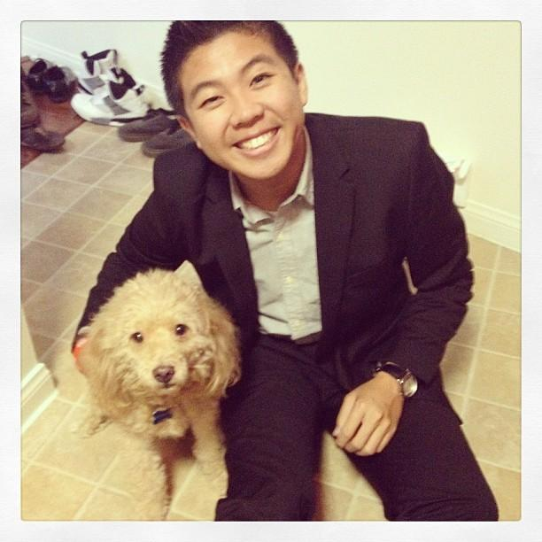
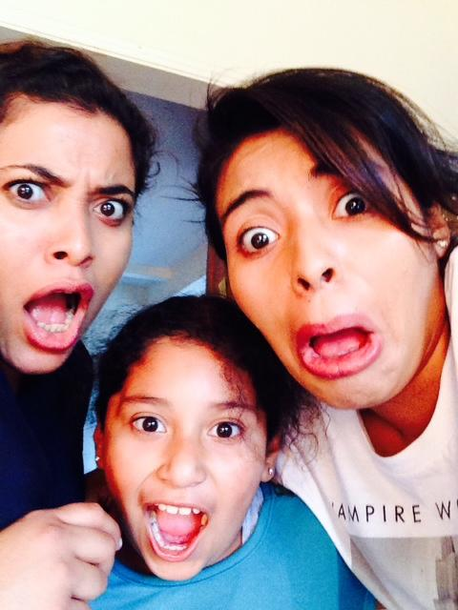
Your Finance Vice Presidents
Raymond Mai
The Banker
Alejandra Chavez
The Deal Maker

Slide 43
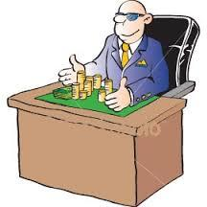
General Information
Actives Dues: $75, Associate Dues: $40
Payment Plan:
$35 Week 3
$20 Week 5
$20 Week 7
$20 Week 9
Electronic Payments
Chase QuickPay
PayPal
Reimbursements through Google Doc
Link found on the APO website
Gas Reimbursements are flat rate of $0.21/mile

Slide 44

AK Term Financials
First Excomm Expense Report on 11.01.13
Budget will be approved during CM3
Committees
Fundraising Committee (2) under Alejandra
Financial Management Committee (1-2) under Raymond

Slide 45
Fundraisers Goals
-At least two fundraiser a week
Restaurant fundraiser
weekly, on campus and off campus
Bruinwalk/Campus fundraisers
bake sales, holiday
TV Tapings
one a week, closest to campus
4. Recycling!

Slide 46
Fellowship VPs
Jessica Cui & Kevin Quizon
fellowship@apo-x.org

Slide 47
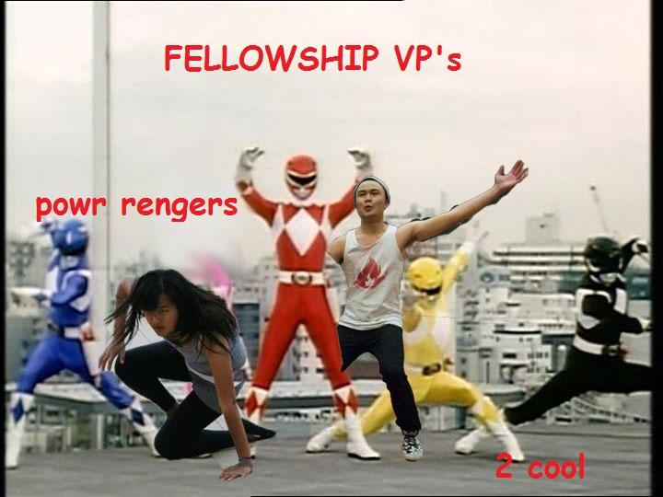
Welcome Back Chi! :)

Slide 48
Join our IM Sports!
Volleyball
Co-Ed
Mondays (6-8:15pm)
Flag Football
Mens ONLY
Thursday (7-8pm)
PLEDGES, ACTIVES, ALUMNI ALL WELCOME :)

Slide 49
Our Awesome Committees
IM Team Committee (2)
-Captains for Flag football and Volleyball. Schedule practices and make sure players attend their games.
LGN/Banquet Committee (3)
-Assist in planning LGN and banquet. Organize drivers for both events.
Secret Brother Committee (2)
-Help update the Secret Brother tracker and collect/distribute presents.

Slide 50
Secret Brother
Sign-ups are now open the calendar under CM3! (Actives Only!)
Fellowship Credit (2 possible)
-Complete 3 out of 4 Secret Brother tasks
-Attend Secret Brother Revealing
Tasks will be completed biweekly. First task will given CM2 and due CM4.

Slide 51
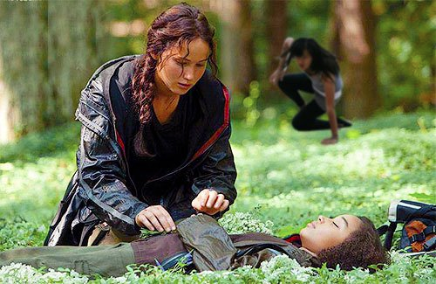
Secret Brother
Be respectful, be mindful and, play nice.
Most importantly, have fun! : )

Slide 52
Bonding With the Brothers!
In-N-Out after meeting!
Chair: Anna Do, Vivian Shih, Julie Nguyen
Boba Run!(10/11)
Chair: Rui Guo
Thrifting in Santa Monica (10/13)
Chair: Rui Guo

Slide 53
Historian
Selena Saenz
historian@apo-x.org

Slide 54
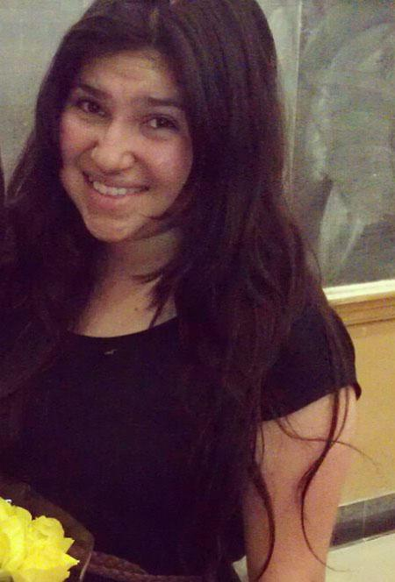
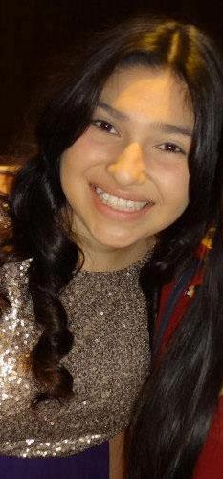
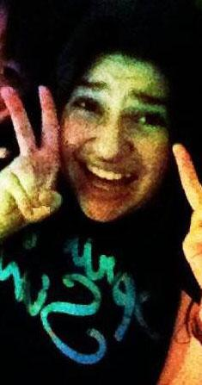
Meet Your Historian!
Hello!
Hola!
Ni Hao!

Slide 55



Drum Roll Please...

Slide 56
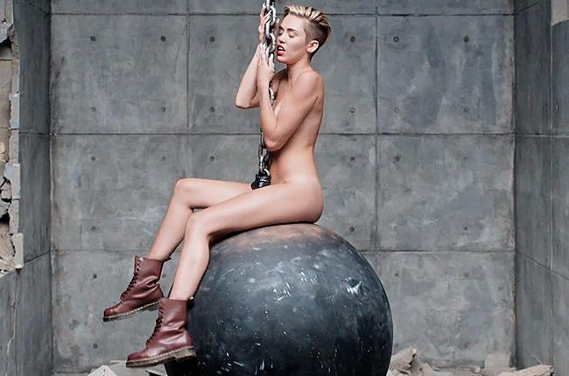
Top Hit of the Week!

Slide 57
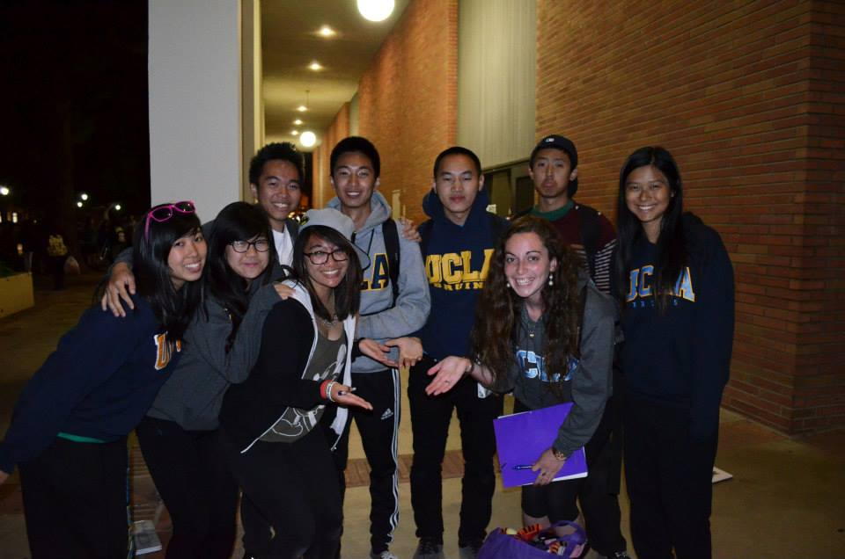
Top Hit of the Week!

Slide 58
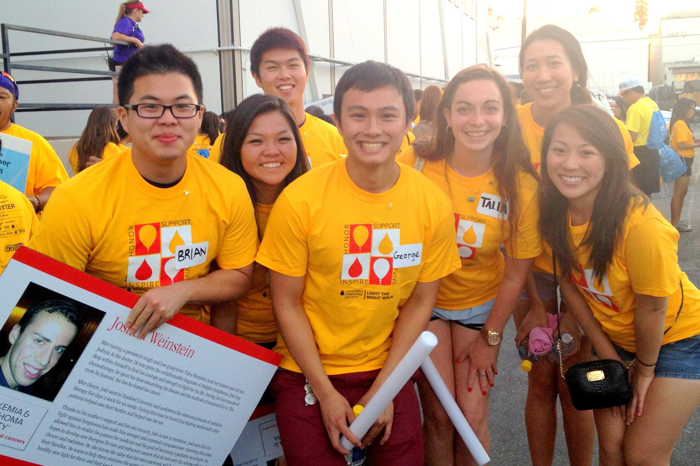
Top Hit of the Week!

Slide 59
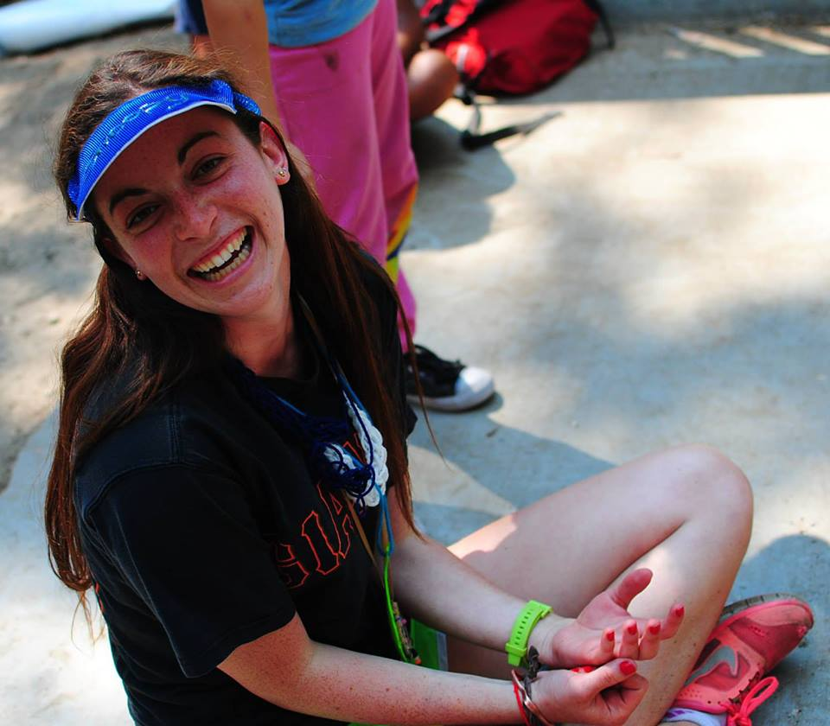
Top Hit of the Week!

Slide 60
Join my committees! :D
APO Webisode (3)
-Along with the other two committee members create a minimum of 3 webisodes! It’s a fun task plus you earn the committee credit! :D Please Join!
Light Bulbs / Slideshow(2)
-Assist in creating new and interactive ideas to share Chi Chapter history to the chapter
-In addition, you will be making the Banquet Slideshow!
BOTW (1)
-Help me nominate a brother who has gone above and beyond in exemplifying our 3 principles! (Leadership, Friendship, and Service)

Slide 61
Sergeant-at-Arms
Maria Valenzuela
saa@apo-x.org

Slide 62
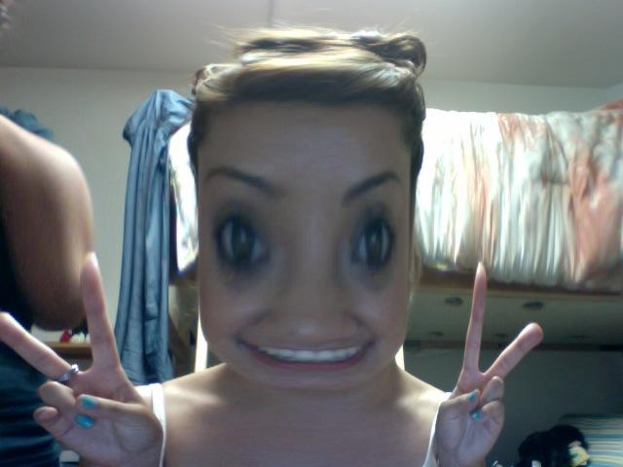
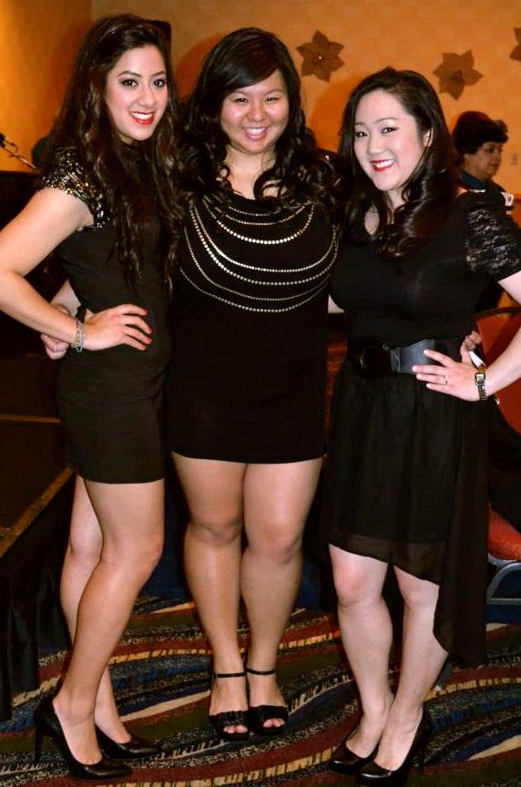
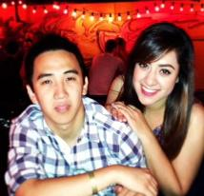
Lets have a Chi-Tastic Term

Slide 63
Strikes
Max number of strikes for Active (4)
Max number of strikes for Pledges (5)
Max number of strikes per event (2)
This accounts for multiple shift sign ups
Neither pledge, nor active need to finish at (0 strikes)

Slide 64
Meeting Regulations
Late:
Please notify me by 6:00 PM
Must come before 7:30 PM and stay the rest of meeting to obtain meeting credit.
No strike if I am notified appropriately
No credit to those who arrive late without notifying me and leave early. Will also result in a 0.5 strike for late arrival. Stay full meeting results in 0.5 strike and full meeting credit.
Leave early:
Notify me by 6:00PM, stay for at least an hour

Slide 65
Meeting Etiquette
PLease be respectful during meetings, this helps the meetings go as fast as possible.
* Clean up after yourselves!
The K.I.S.S list (Keep It Silent Stupid)
3 checks = Strike
And it will be enforced by myself as well as my committee.
* Email notification of receiving a strike so that there is no miscommunication

Slide 66
Strikes/ Makeups
Late= 0.5
Flake an event = 1
Flaked event results in the makeup of that event + your required.
Option (1) LFS: 1chair/workshop +1 fridshp + 1 hr service
Option (2) 3 hr service
*Notify me that it counts towards your strike & comment below on the event stating what you are using your credit towards.

Slide 67

Searching for a Committee
(2) Attendance committee members
Roles/ qualifications:
Taking attendance, helping pick A.B.E.A
(2) K.I.S.S Committee members
Roles/ qualifications:
Patrolling meetings/
in charge of K.I.S.S list

Slide 68
Interchapter Chair
Olivia Pardo
interchapter@apo-x.org

Slide 69
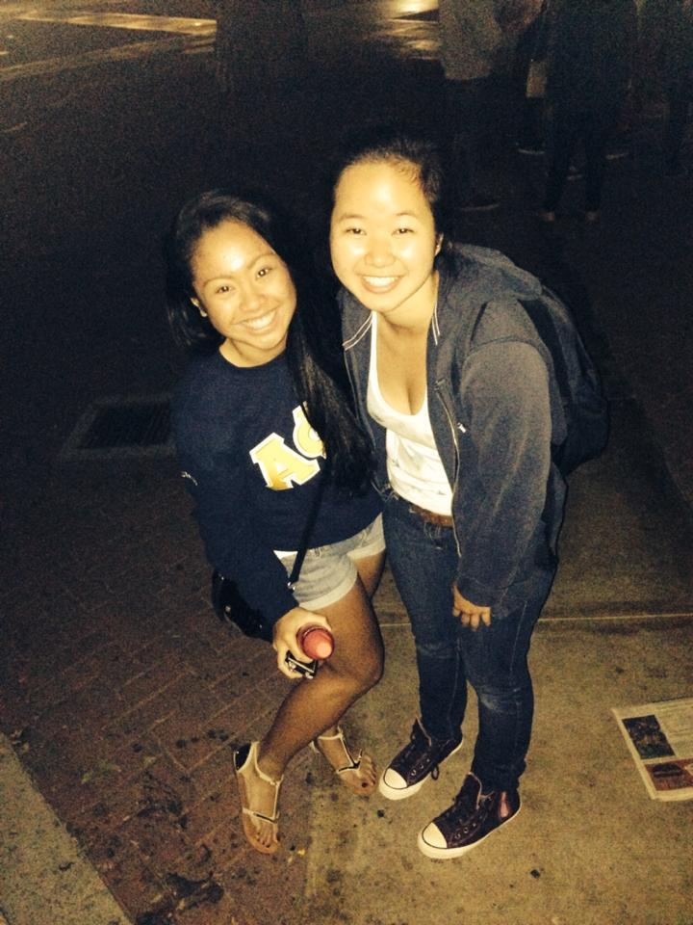
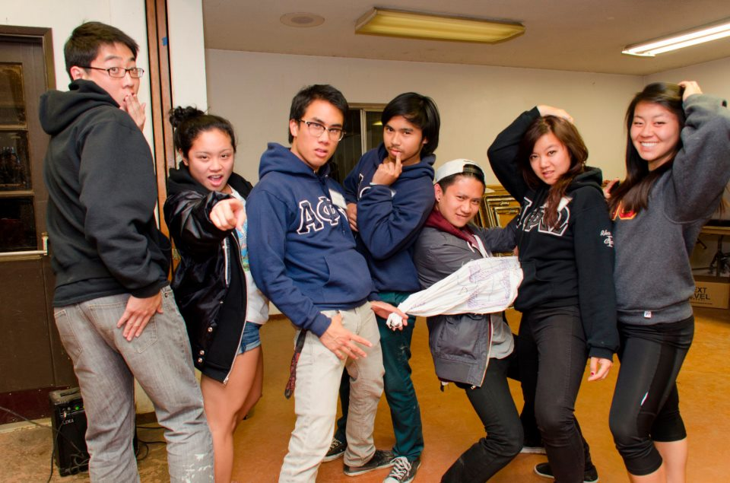
HI THERE!

Slide 70
Updates & Reminders
IC Penpal
Alpha Kappa
Sign up by next Wednesday (10/16)
Join my committees!
ICDC Committee (3)
IC Penpal (2)
More events to be posted! ^__^

Slide 71
Chair of the
Advisory Committee
Tristan Darvin
cac@apo-x.org

Slide 72
CAC Updates
Chairman Office Hours TBA (please keep an eye out for updates)
To Alpha Kappa Pledges: Keep an eye out for an email from me (included special guidelines regarding my interview)
Alumni Spotlight (soon to come)

Slide 73
CAC Updates
I will be sending Internship Opportunities to you guys in the near future (business, engineering, medical, etc)
Need career/resume/professional advice? Feel free to contact me!

Slide 74
CAC Updates
Questions/Concerns/Advice about Chi Chapter?
Private Discussions welcomed
Anonymity Respected
Email: apoxcac@gmail.com
cac@apo-x.org

Slide 75

CAC Updates
I wish you all the best this term and quarter!

Slide 76
Chapter Business

Slide 77
Last Announcements

